Slide 1

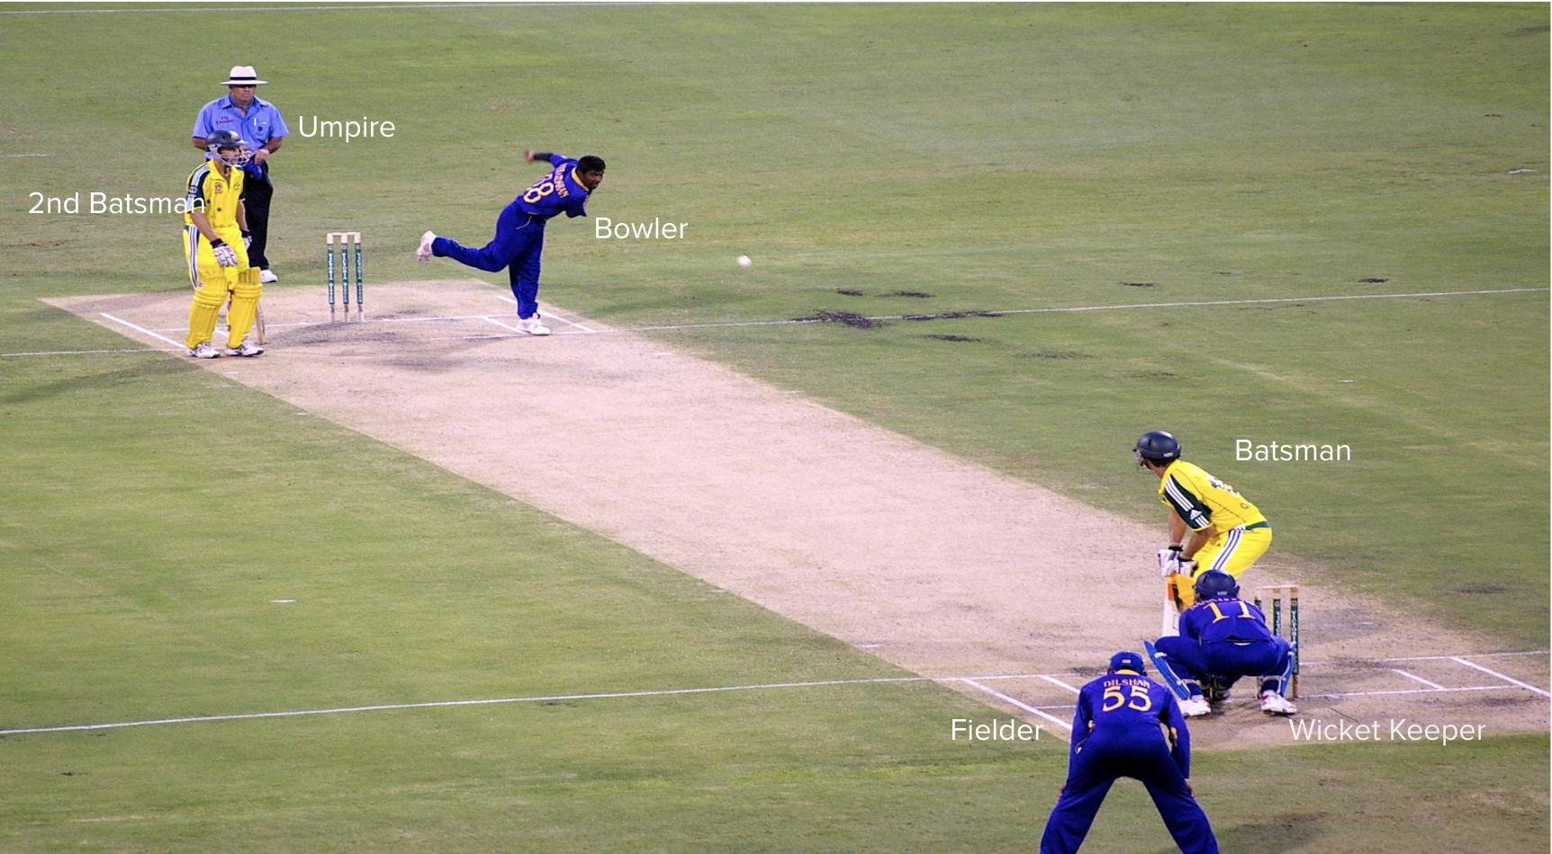
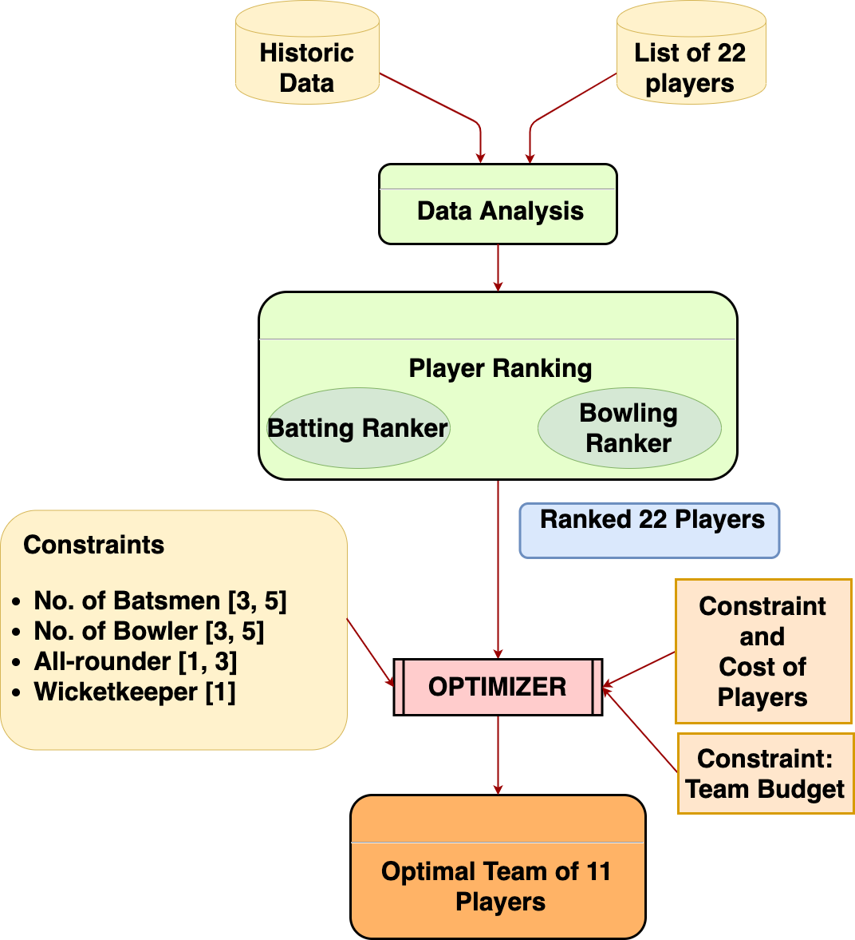
SUPER 11
Guneet Khosla | Karthik Nama Anil | Pranit Kaul | Prithvi Alva Suresh
Summary
Cricket is a game played between two teams of 11 players on a field at the center of which is a 20-metre pitch with a wicket at each end, each comprising two bails balanced on three stumps. In fantasy sports leagues, users select a set of players to form a team by anticipating the performance of each player in the upcoming match. The participant with the best team wins a reward.
Problem Statement
We aim to select the best 11 players for a fantasy cricket league from the two playing teams based on past player performance under the specified budget constraints
Motivation
Despite the large betting market for Cricket and the growing number of fantasy cricket users, limited research work has been carried out for the Cricket team selection. People spend hours selecting a decent team before each match; we aim to shorten the time spent by automating the analysis, which will also give novices a winning chance in the contests.
Data
Indian Premier League (Cricket) Ball-by-Ball Cricket Data is available on Kaggle comprising the match statistics of all IPL Cricket matches between 2008 and 2017 ball-by-ball.
Exploratory Data Analysis
To calculate player utility values, we analyzed player metrics like runs scored, wickets taken, strike rate, bowling economy and many more. We used visualizations to understand the distribution of these metrics.
Innovations
Implemented Integer Linear Programming to select the best performing team with the given budget and gameplay constraints.
Modified the minimization methods to account for the imbalance in batting, bowling, wicketkeeping strength while implementing the optimizer.
Methodology
Evaluation(Backtesting Strategy)
For testing our Predicted 11 team, we create an Optimal 11 team, that is the best playing 11 as per that match. We calculated the Optimal 11 team after rewarding the players according to the fantasy sports points system for our test data match. According to these results, we have achieved approx. 85% accuracy in predicting the ideal team. Additionally, it was observed that our selected team performed exceptionally well on the test dataset (IPL 2017) and our players achieved a high overall score.
Simulation Results
deliveries.csv
ball-by-ball data of all the IPL matches including data of the over, batsman, bowler, runs scored, wickets, etc.
21 columns 150k rows
matches.csv
details related to the match such as location, contesting teams, umpires, results, etc.
18 columns 636 rows
Match 14 IPL 2017
15TH April 2017, Saturday
Eden Gardens, Kolkata

